Slide 1
14 – 3
Mechanical Advantage
and Efficiency

Slide 2
Lesson Objectives
I can compare a machines actual mechanical advantage to its ideal mechanical advantage.
I can explain why the efficiency of a machine is always less than 100%.
I can calculate mechanical advantage and efficiency.

Slide 3
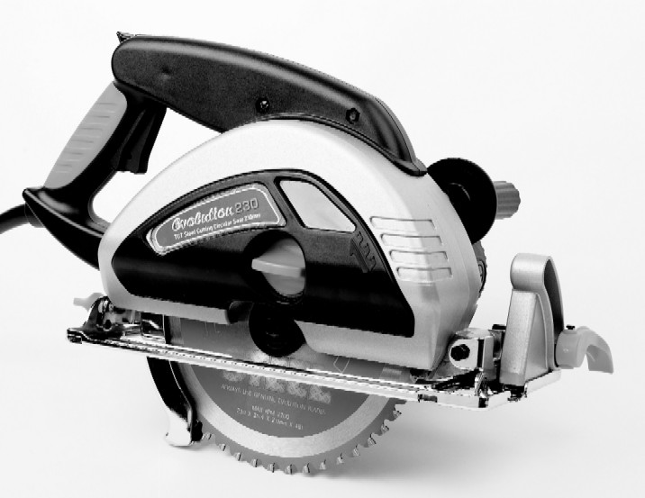
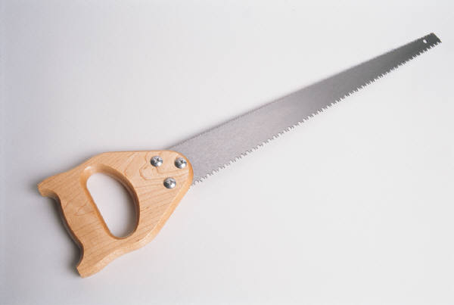
Mechanical Advantage
Ways of making WORK easier to accomplish (less effort):
OR
Using a machine allows for more
power with less effort from you!
This is why we use machines.
Both will get the same work done,
but which one takes less effort
to accomplish the work?
Mechanical Advantage is all about getting the machine to make the job as easy for you as possible but does not do more work!
Think: Does more power
always mean less effort?

Slide 4
Mechanical Advantage (MA)
– expressed in a ratio WITH NO UNITS!!
The number of times a machine multiplies the input force.

Slide 5
2 types of mechanical advantage
IDEAL
Involves no friction.
Is calculated differently for different machines
Usually input distance/output distance
ACTUAL
Involves friction.
Calculated the same for all machines
Usually Output force/Input Force

Slide 6
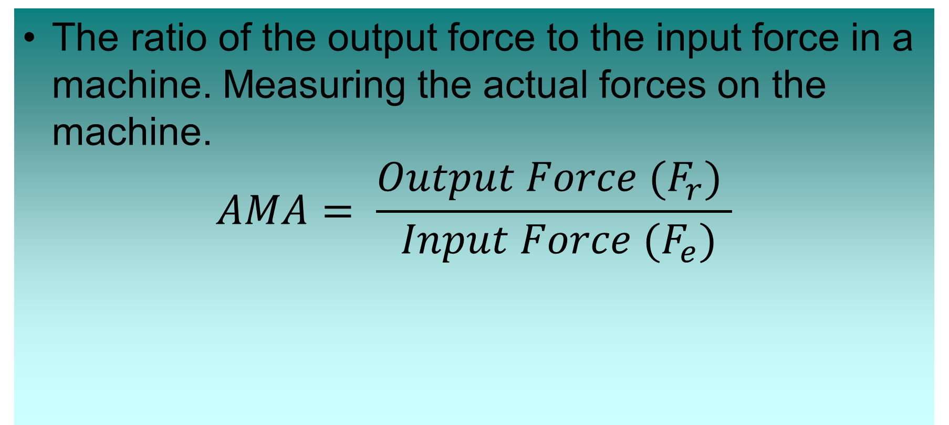
Actual Mechanical Advantage (AMA)
The ratio of the output force to the input force in a machine. Measuring the actual forces on the machine.
$$AMA= \frac{{Output Force (F}_{r}) }{ {Input Force (F}_{e})}$$
The higher the Mechanical Advantage, the easier it is to move something.
We want to make the MA number bigger!!!
Means more Output force from the machine,
less Input force from you! = less effort!!!
Basic M.A.= 1

Slide 7
Mechanical Advantage
We want to make this number
bigger = easier to do
What the machine does
Force
5 N
8 N
= 1
= 4
5 N
2 N
Force
Notice that when there is more
Output than Input force, the
MA number increases!
What you do
The Higher the Mechanical Advantage, the Easier it is to accomplish the work.

Slide 8
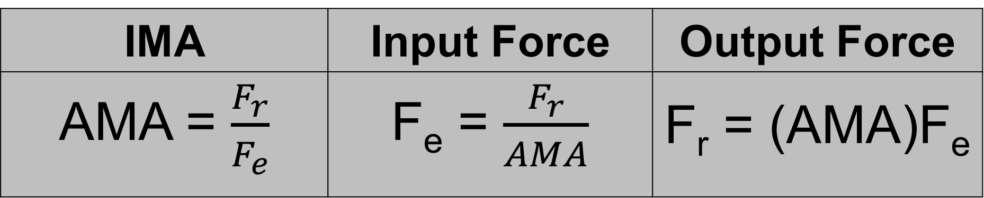
AMA Related Equations
IMA | Input Force | Output Force
AMA = $\frac{F_{r}}{F_{e}}$ | F_{e} = $\frac{F_{r}}{AMA}$ | F_{r} = (AMA)F_{e}
Represents | Common Units (SI)
AMA = Actual Mechanical Advantage | ----------------------
F_{r} = Output force/resistance force | Newtons
F_{e} = Input force/effort force | Newtons

Slide 9
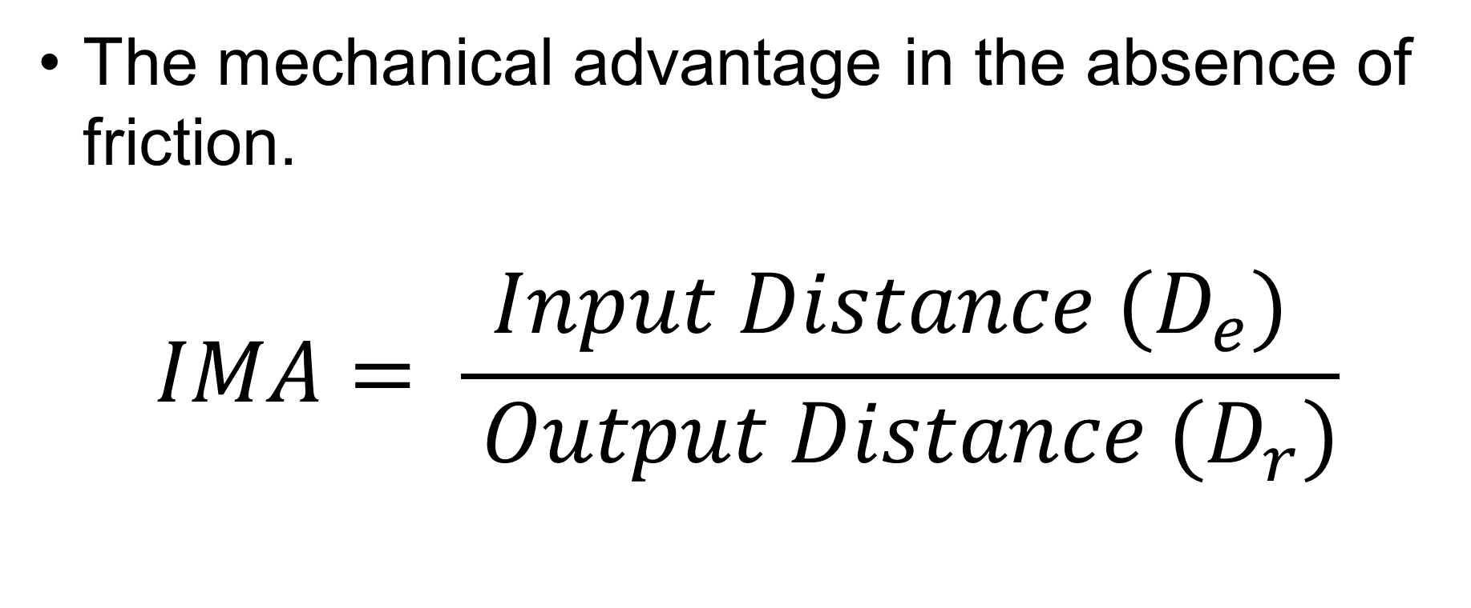
Ideal Mechanical Advantage (IMA)
The mechanical advantage in the absence of friction.
$$IMA= \frac{{Input Distance (D}_{e}) }{ {Output Distance (D}_{r})}$$

Slide 10
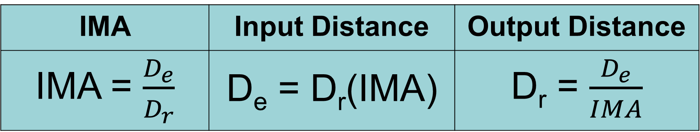
IMA Related Equations
IMA | Input Distance | Output Distance
IMA = $\frac{D_{e}}{D_{r}}$ | D_{e} = D_{r}(IMA) | D_{r} = $\frac{D_{e}}{IMA}$
Represents | Common Units (SI)
IMA = Ideal Mechanical Advantage | ----------------------
D_{r} = Output distance/resistance distance | Meters
D_{e} = Input distance/effort distance | Meters

Slide 11

Different mechanical advantages:
MA equal to one. (output force = input force)
Change the direction of the applied force only.
Mechanical advantage less than one
An increase in the distance an object is moved (d_{r})
Mechanical advantage greater than one
Output force is greater than input force.
As MA increases, the distance the output force moves decreases.

Slide 12
M. A. of Levers
Think: If the Input and Output are exactly
the same is there any point to using a machine?
Don’t forget: Work of Input = Work of Output
In this case, with the fulcrum right in the center, the forces,
distance and total input/output work are exactly the same!
Think: when force and
distance are exactly the
same; is there any M.A?
Force
Force
Distance
Distance
Work = Input Force x Input Distance Work = Output Force x Output Distance

Slide 13
So how can we increase M.A. of a lever?
We have to adjust how we set up the machine itself!
Notice that mathematically, even though the amounts of distance and force
have changed the total work done on both sides remains the same!
Notice what happens to
the force and distance of
each side when we move
Fulcrum closer to the mass
In this case we can move the fulcrum and change
the distance of the output and input:
Output: Less distance but more force!
Input: More distance but less force!
Force
Force
Distance
Distance
Work = Output Force x Output Distance
Work = Input Force x Input Distance

Slide 14
M.A. of an Incline Plane:
The same amount of work was accomplished with less force on your part!
The ramp is now
longer and less steep
Work that needs to
be accomplished
Distance
To give this simple machine more mechanical advantage, simply make the ramp longer
Notice: Did the height of the ramp change?

Slide 15
M.A. of Pulleys:
Notice that the force and
distance is equal
When you use a basic single pulley
setup, the M.A. = 1
Distance
Input Work (Effort Side)
Distance
In order to get M.A. you need to
change the distance of your input pull!
Output work side
Force
Force

Slide 16
Movable Pulleys give M.A.
Pulleys only have mechanical advantage when you use a moveable pulley with your setup.
Input (Effort Side)
Force
Output (Resultant Side)
Distance
Work = Force x Distance
Watch the difference in distance for
Input and the Output!
Notice that you have to pull more rope to
accomplish the same output distance.
Force
Distance
This is the point! More Input distance will lessen
then amount of Input force needed!
Work = Force x Distance
When you increase the Input distance, the Input force automatically goes down and the Output force automatically goes up!!!

Slide 17
Movable + Fixed Pulley
Combination (“Block and Tackle”)
Fixed Pulley
Pulleys only have mechanical advantage when you use a moveable pulley with your setup.
Output Force (Result)
Input Force (Effort)
Moveable Pulley
By making a combination of Pulleys, we are adding
even more input distance, which should lower out
Input force even more = more M.A.!!!

Slide 18
Question
Why is the actual mechanical advantage (AMA) always less than its ideal mechanical (IMA) advantage.
- The presence of friction results in AMA being less than IMA.

Slide 19
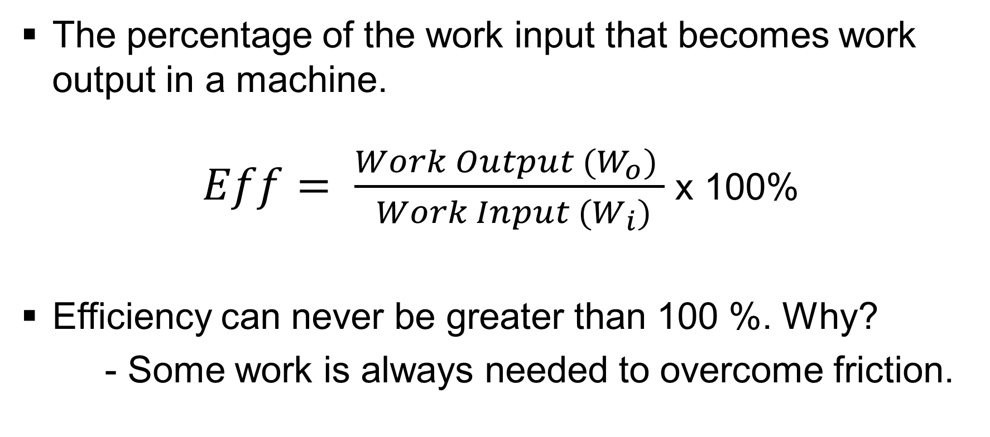
Efficiency
The percentage of the work input that becomes work output in a machine.
$Eff= \frac{{Work Output (W}_{o}) }{ {Work Input (W}_{i})}$ x 100%
Efficiency can never be greater than 100 %. Why?
- Some work is always needed to overcome friction.

Slide 20
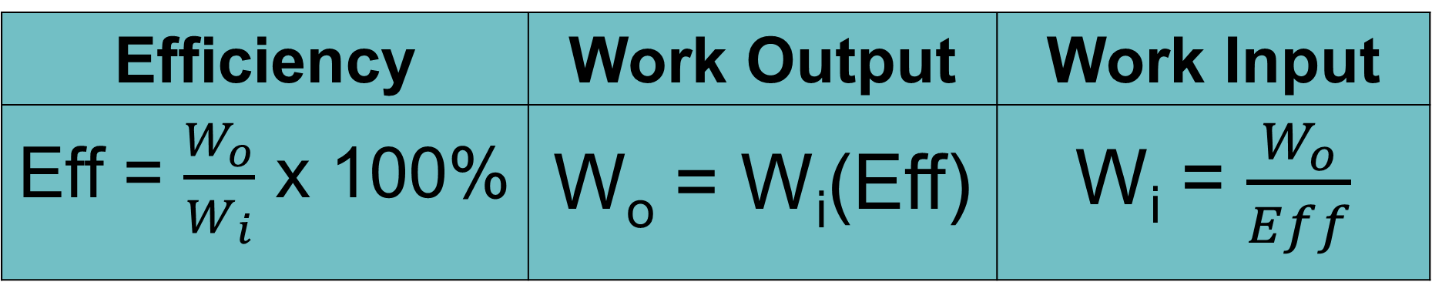
Efficiency Related Equations
Efficiency | Work Output | Work Input
Eff = $\frac{W_{o}}{W_{i}}$ x 100% | W_{o} = W_{i}(Eff) | W_{i} = $\frac{W_{o}}{Eff}$

Slide 21
Ideal Machines
A machine that is 100% efficient is called an ideal machine.
Do these exist? Why or why not?
- Ideal machines do not exist because we have been unable to completely overcome friction.

